Slide 2
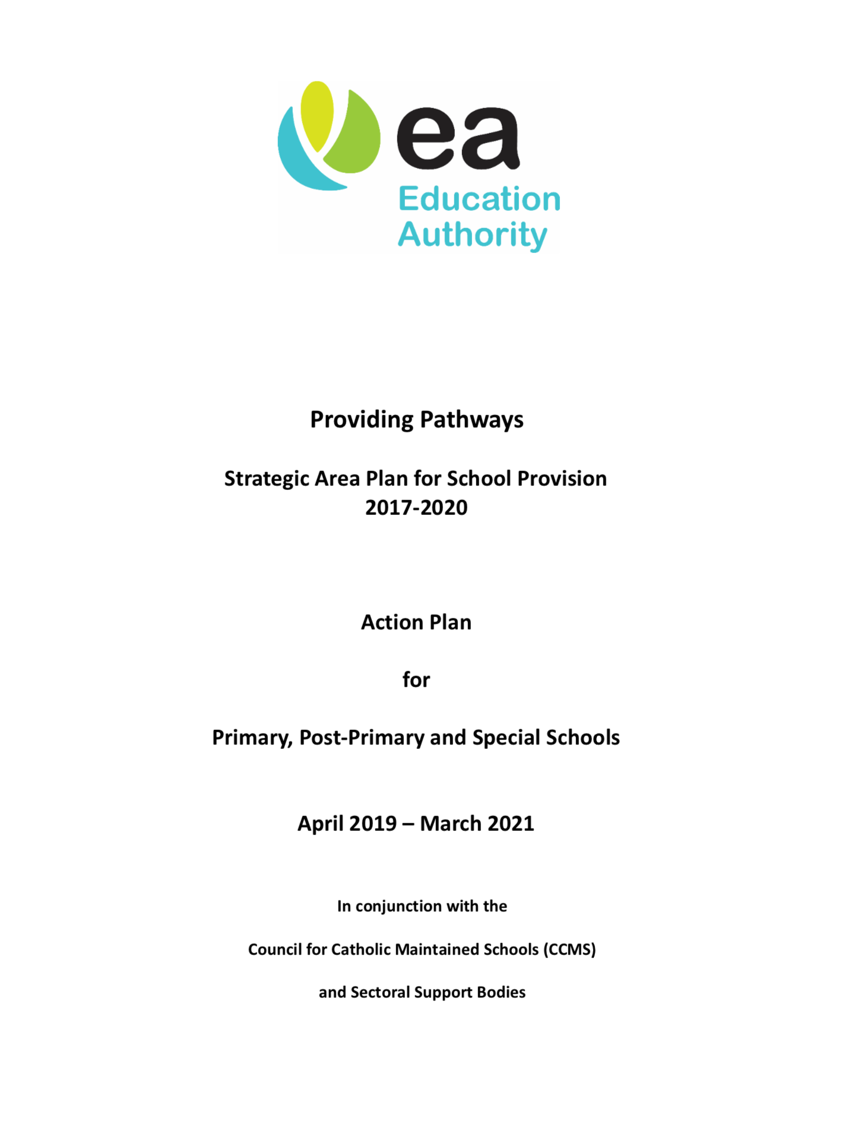
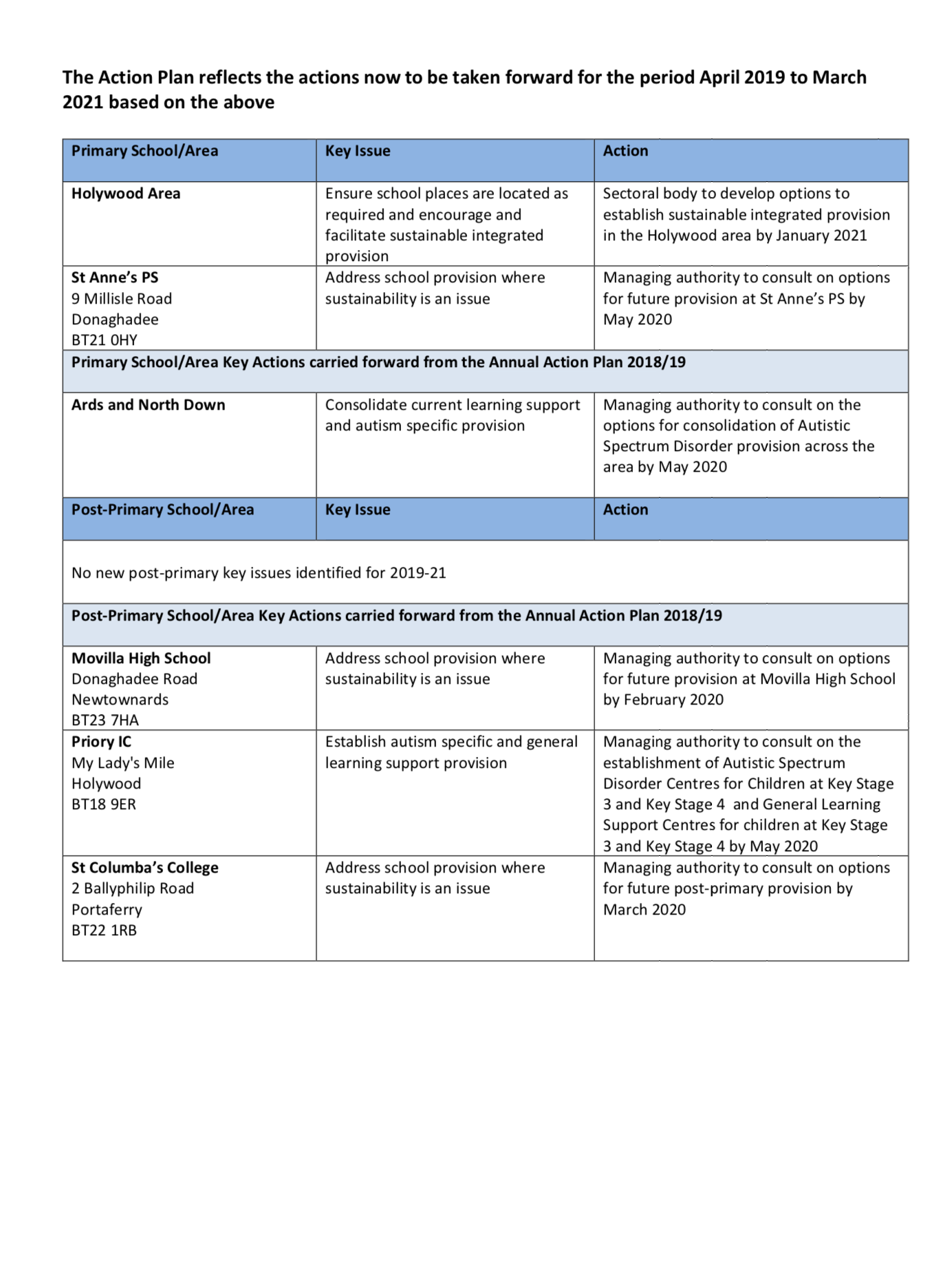
Education Authority / CCMS Area Plan
June 2019

Slide 3
Review Process:
November to January – CCMS & Principal
CCMS & Board of Governors
February
CCMS & Parents / Pupils

Slide 4
Tell CCMS about St. Anne’s
Why choose St. Anne’s over other schools
St. Anne’s should stay open and allowed to grow

Slide 5
2 Weeks today:
February 27, 7.30pm
Church Hall

Slide 6
Department of Education:
Sustainable Schools Policy
6 criteria:
Quality educational experience | Stable enrolment trend | Sound financial position
Strong leadership | Accessibility | Links with the community

Slide 7
Quality educational experience | Stable enrolment trend | Sound financial position
Strong leadership | Accessibility | Links with the community
Small primary schools : 105 pupils
Composite classes (3 age groups)
Fewer opportunities for pupils & staff ?

Slide 11
Quality educational experience | Stable enrolment trend | Sound financial position
Strong leadership | Accessibility | Links with the community

Slide 12
Quality educational experience | Stable enrolment trend | Sound financial position
Strong leadership | Accessibility | Links with the community
St. Anne’s in deficit ? Yes
Measures taken to reduce overspend from £20k to £6k
Growing enrolment will reduce deficit

Slide 13
Quality educational experience | Stable enrolment trend | Sound financial position
Strong leadership | Accessibility | Links with the community
Is Enrolment decreasing? No. +70%
School numbers expected to exceed 60 in 2022

Slide 15
Quality educational experience | Stable enrolment trend | Sound financial position
Strong leadership | Accessibility | Links with the community
Is Enrolment decreasing? No. +70%
School numbers expected to exceed 60 in 2022
The only Faith school for 7 miles

Slide 16
20% Catholic; 60% Protestant; 20% other
I want a
Faith School
for my child

Slide 17
I want a Faith School for my child
Spiritual development is equally important in 21st Century
Prepare our children:
Materialism, Social media,
modern pressures, mental health,
Inclusion and accepting difference

Slide 21
Review Process:
Not the intention to mechanically apply criteria ;
Criteria do not automatically mean a school should close;
They provide an indication of whether action may be required to address an emerging trend.

Slide 22
2 Weeks today:
February 27, 7.30pm
Church Hall

Slide 23
A positive outcome:
Attend the Review consultation
Support the school
Be discreet – little folk have big ears!

Slide 24
Thank you.

